Slide 1
STAT 157 - Group #19
Parameterizable Single GAN Multi-Style Image Generation
Benson Yuan, Daiyaan Arfeen, Jack Sullivan, Jesse Zhang, Mohammed Shaikh

Slide 2
Background
- Applying a style from an image to any other image using CNNs
- State-of-the-art style transfer generates photo-realistic images from semantic labels.
- Does not support multiple style with one generative adversarial network (GAN).
- Does not support explicit parameterization to control mixture of different styles.

Slide 3
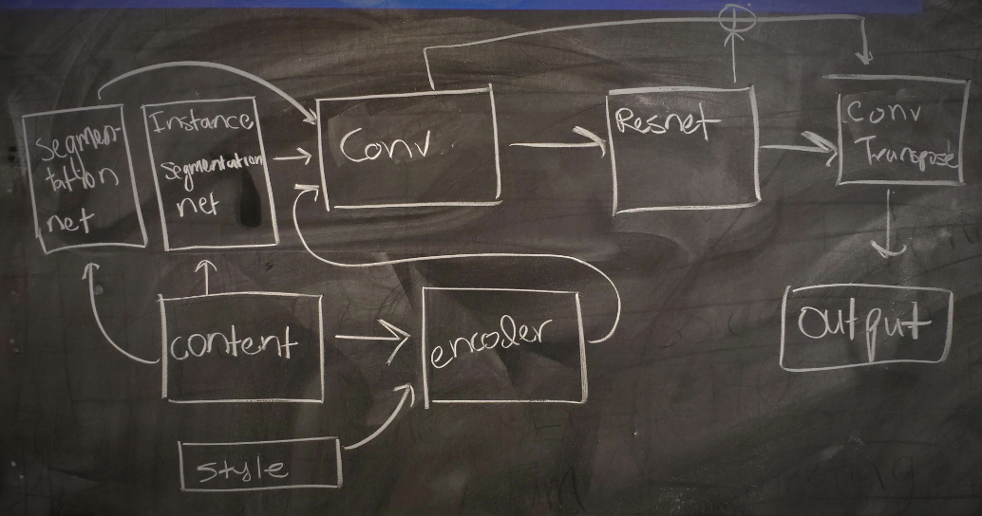
Current Progress / Future Work
Trained our baseline (Pix2pixHD) that generate one style
Comparing using one encoder for each style, multiple encoders for each style, and a discriminator for each style across multiple styles
Brainstorming novel architectures to achieve multi-style image generation
Want to add unique global style information that the feature embedding encoder does not already provide
Want to change the style encoding to allow our GAN to traverse the manifold of art styles

